Slide 1
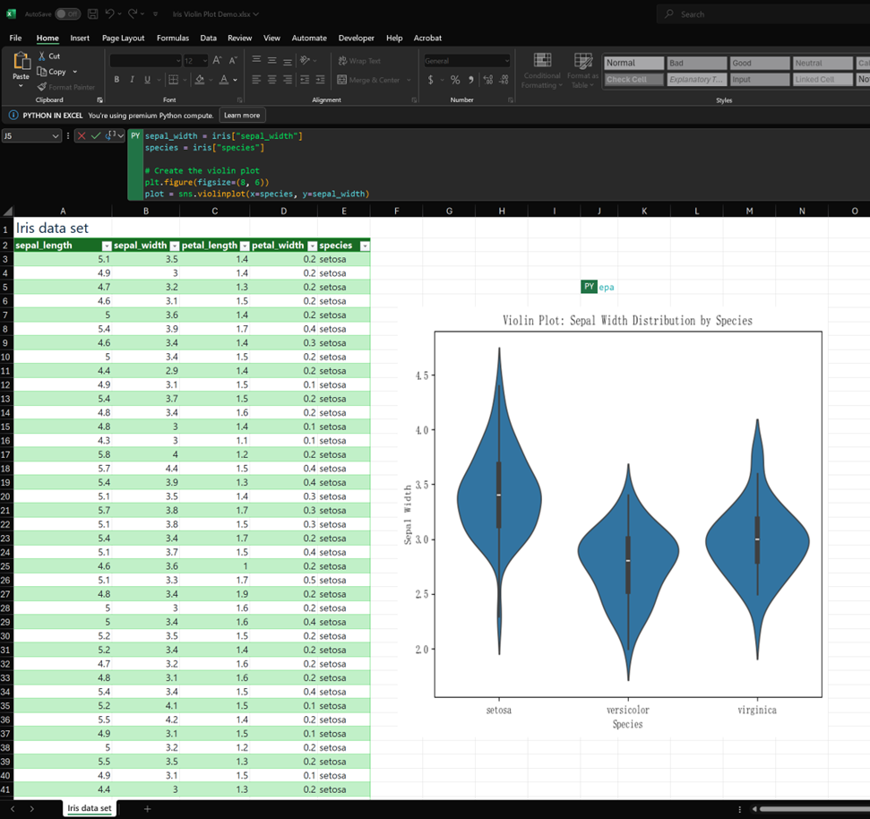
Enhance Excel with Python: Create a Violin Plot from the Iris Dataset
A Step-by-Step Guide for Business Intelligence and Data Science Professionals

Slide 2
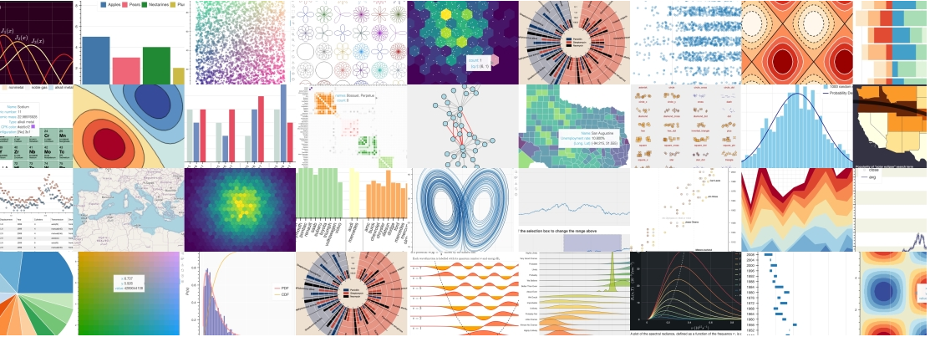

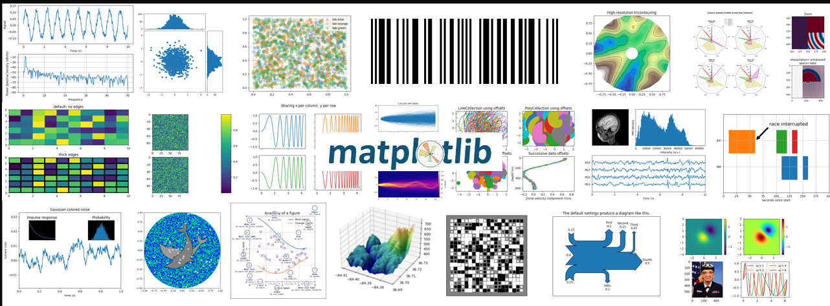
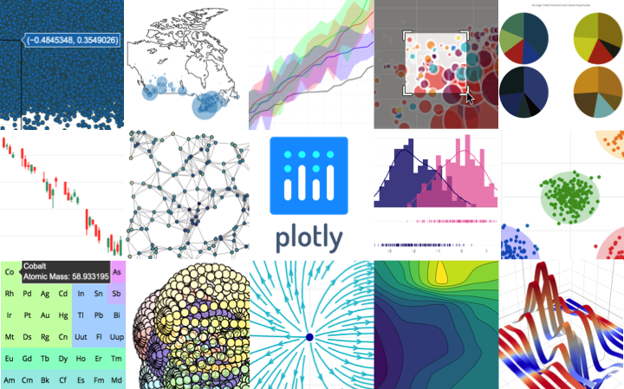
Why Use Python in Excel?
Excel is powerful but limited in advanced visualizations.
With Python’s libraries like Matplotlib, Plotly, and Bokeh, you can extend Excel's capabilities beyond its native limits.
Example: Create a Violin Plot to visualize data distribution—something not natively available in Excel.

Slide 3
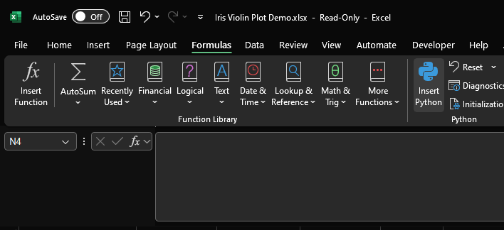
How to Get Started with Python in Excel
Availability:
Python in Excel is available for Enterprise and Business users running Microsoft 365.
To enable Python in Excel:
Use the Insert Python option in the Formulas tab
Alternatively, simply type =PY in a cell.

Slide 4
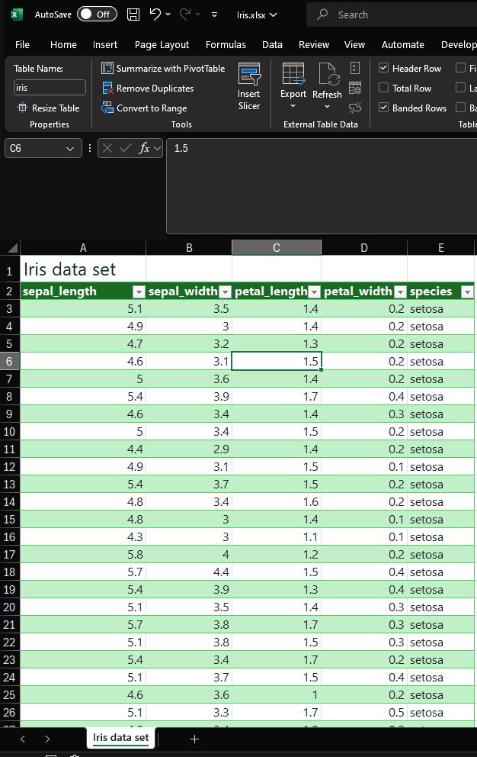
Download the Iris Dataset
Download the Iris dataset
https://github.com/dallasdigitaldata/linkedin_excel_funcs/blob/main/PythonInExcel/iris/Iris.xlsx
Click the download button once you access the GitHub page.

Slide 5
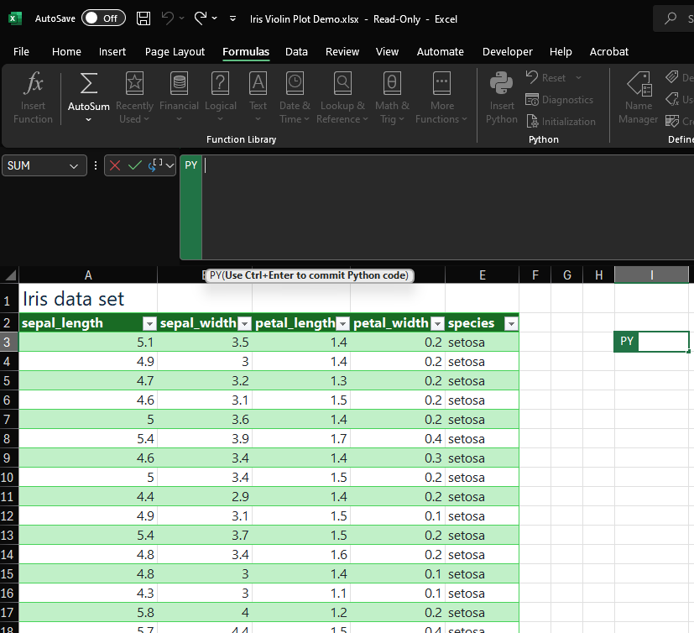
Insert Python Code
In cell I3, type =PY() and paste the Python code from the example.
See below how it changes to Python Entry mode.

Slide 6
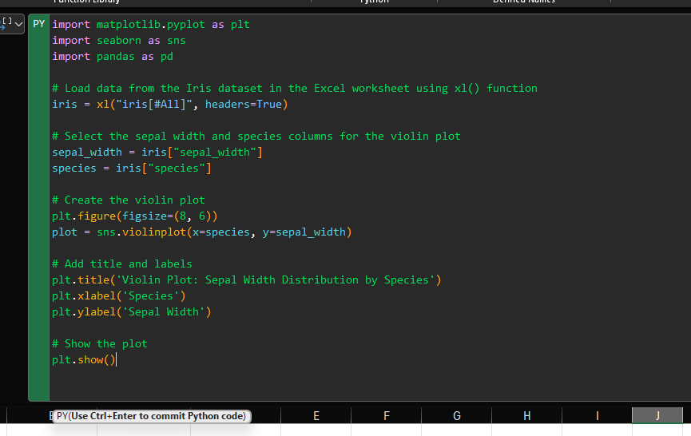
Insert Python Code
Tip: You can type the code manually if you want to practice coding in Excel.
Use Ctrl + Enter to run the cell

Slide 7
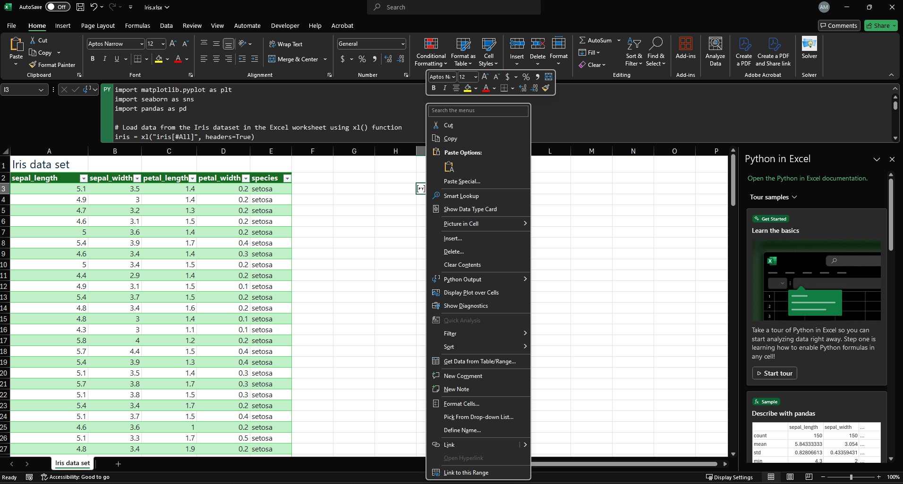
Display the Python Plot
Right click on the new python image and click Display Plot over Cells

Slide 8
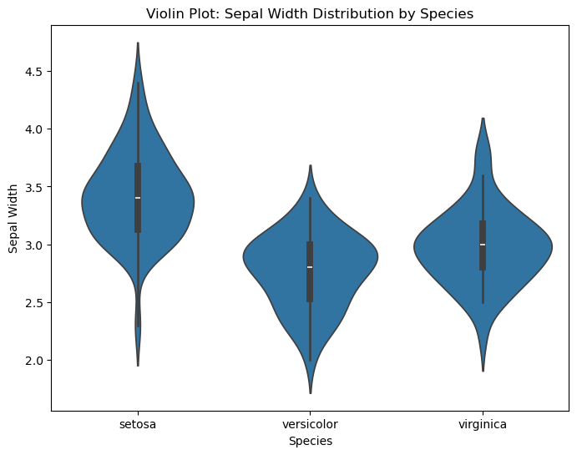
Plot in all its Glory!
Now we can see our Violin Plot

Slide 9
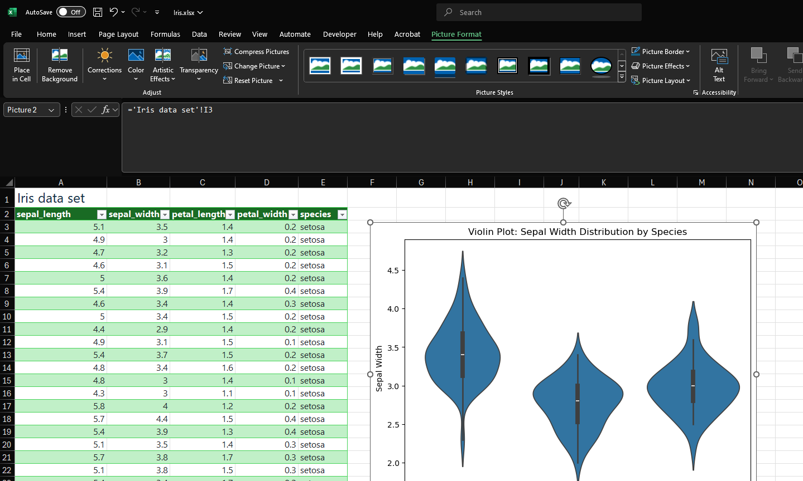
Conclusion and Next Steps
By integrating Python into Excel, you open up a range of new possibilities for data analysis and visualization.
Download the Iris dataset and try more plots like boxplots or histograms.
Explore other Python libraries (e.g., plotly) for interactive visualizations.Experiment with different datasets to unlock Excel’s full potential with Python.

